Slide 1

Customer Shopping Behavior Analysis
3,900 purchases • 18 columns • goal: uncover spending, segments, preferences, subscriptions

Slide 2

Dataset Summary
Size
Key Features
Rows: 3,900 • Columns: 18
Demographics, purchase details, behavior, subscription
Missing Data
37 missing values in Review Rating

Slide 3

EDA — Python Workflow
Loading
Missing → Impute
Imported with pandas; df.info(), .describe()
Review Rating: median by product category
Standardize
Renamed columns to snake_case

Slide 4
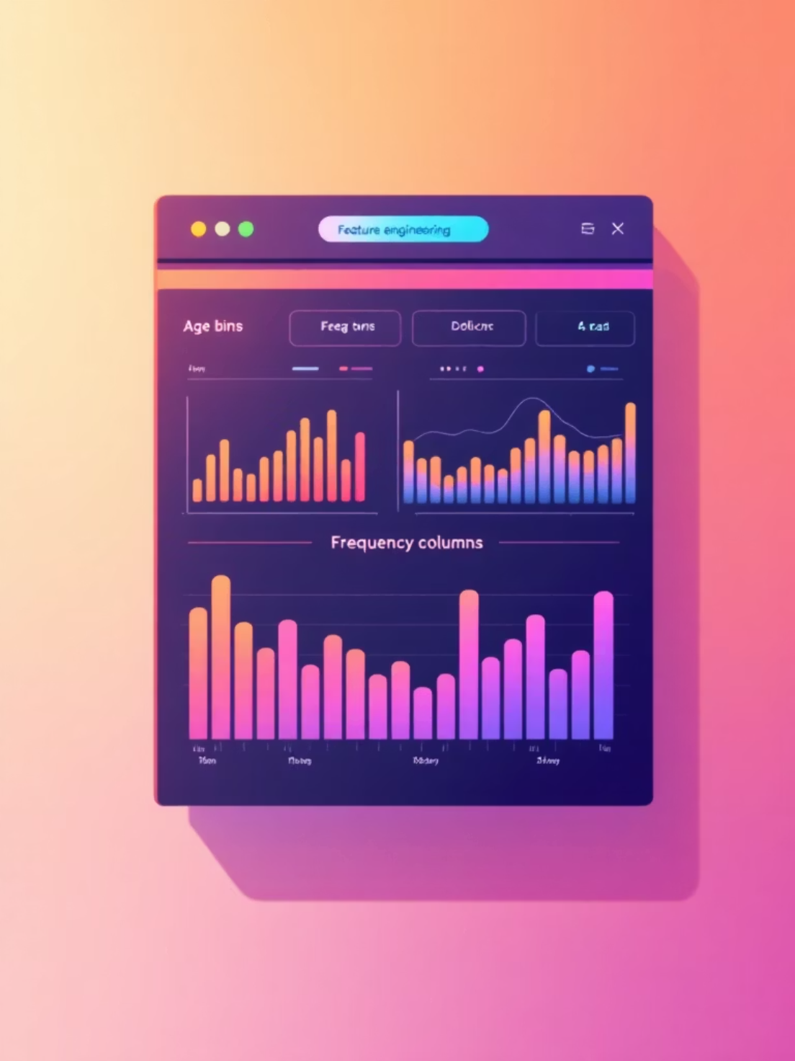
Feature Engineering
age_group from age bins
purchase_frequency_days derived
dropped promo_code_used (redundant with discount_applied)
loaded cleaned data to PostgreSQL

Slide 5

Revenue by Gender
Female: 75,191 • Male: 157,890
Insight: Males generated higher total revenue

Slide 6
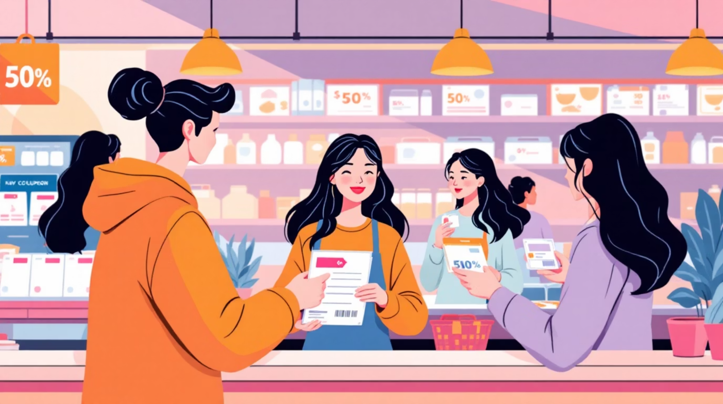
Discount & High-Spenders
839 rows: customers who used discounts yet spent above average
Examples
customer_id 2 → 64, 3 → 73, 4 → 90, 7 → 85, 9 → 97

Slide 7




Top Products by Rating
Gloves
Sandals
Boots
Avg rating 3.86
Avg rating 3.84
Avg rating 3.82

Slide 8
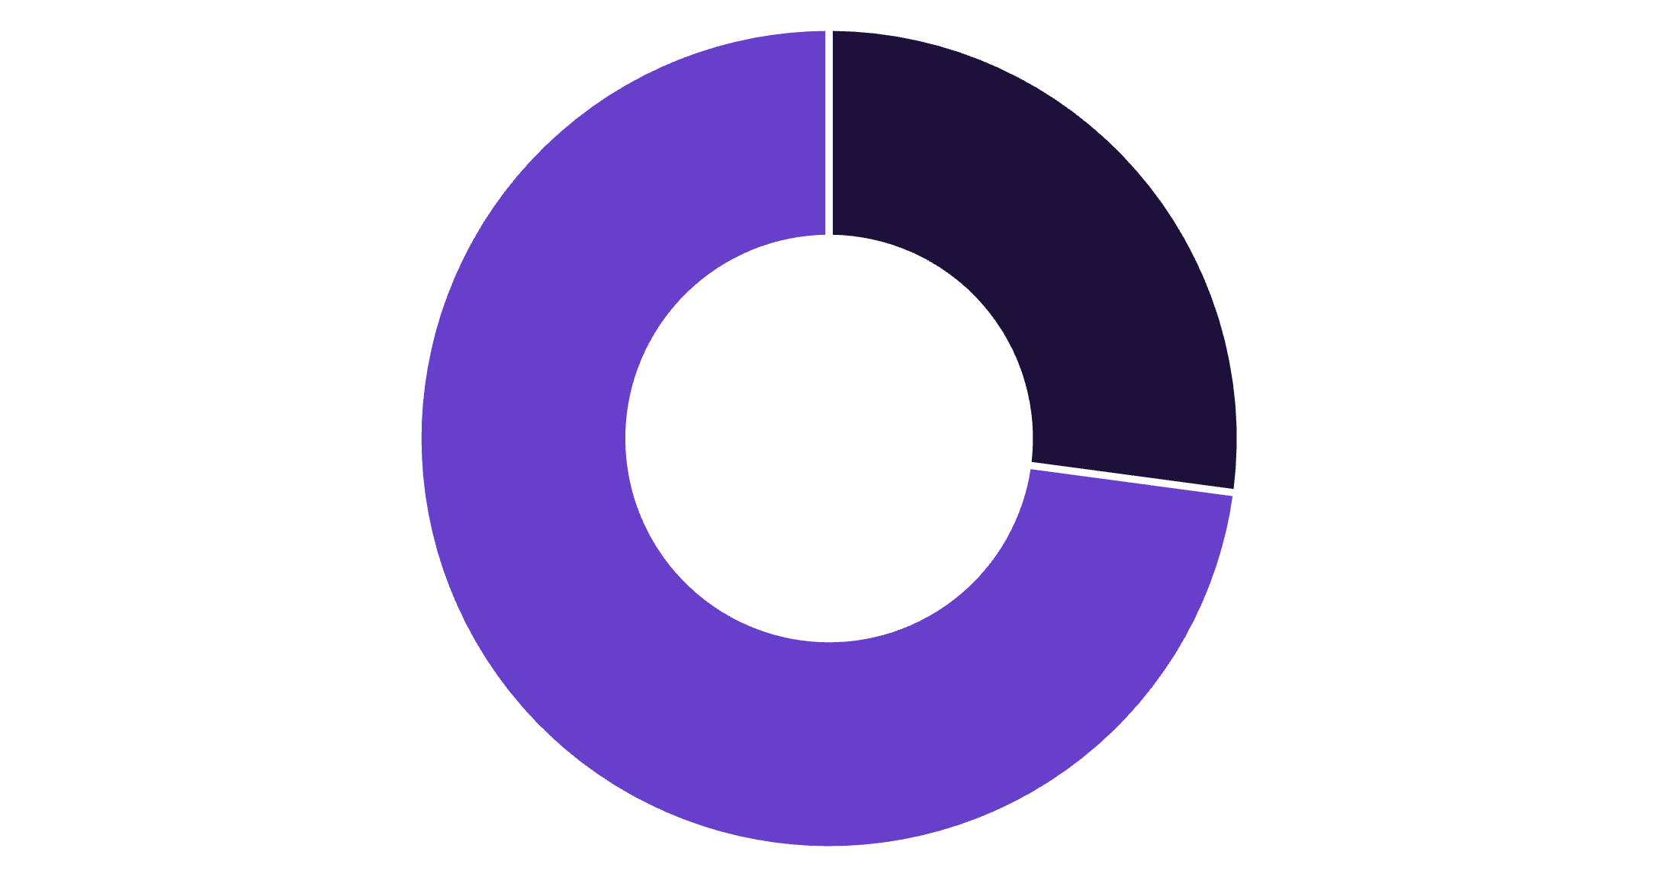
Subscribers vs Non-Subscribers
Yes: 1,053 customers • Avg spend $59.49 • Revenue $62,645
No: 2,847 customers • Avg spend $59.87 • Revenue $170,436
Action: opportunity to boost subscriptions
Yes
No

Slide 9
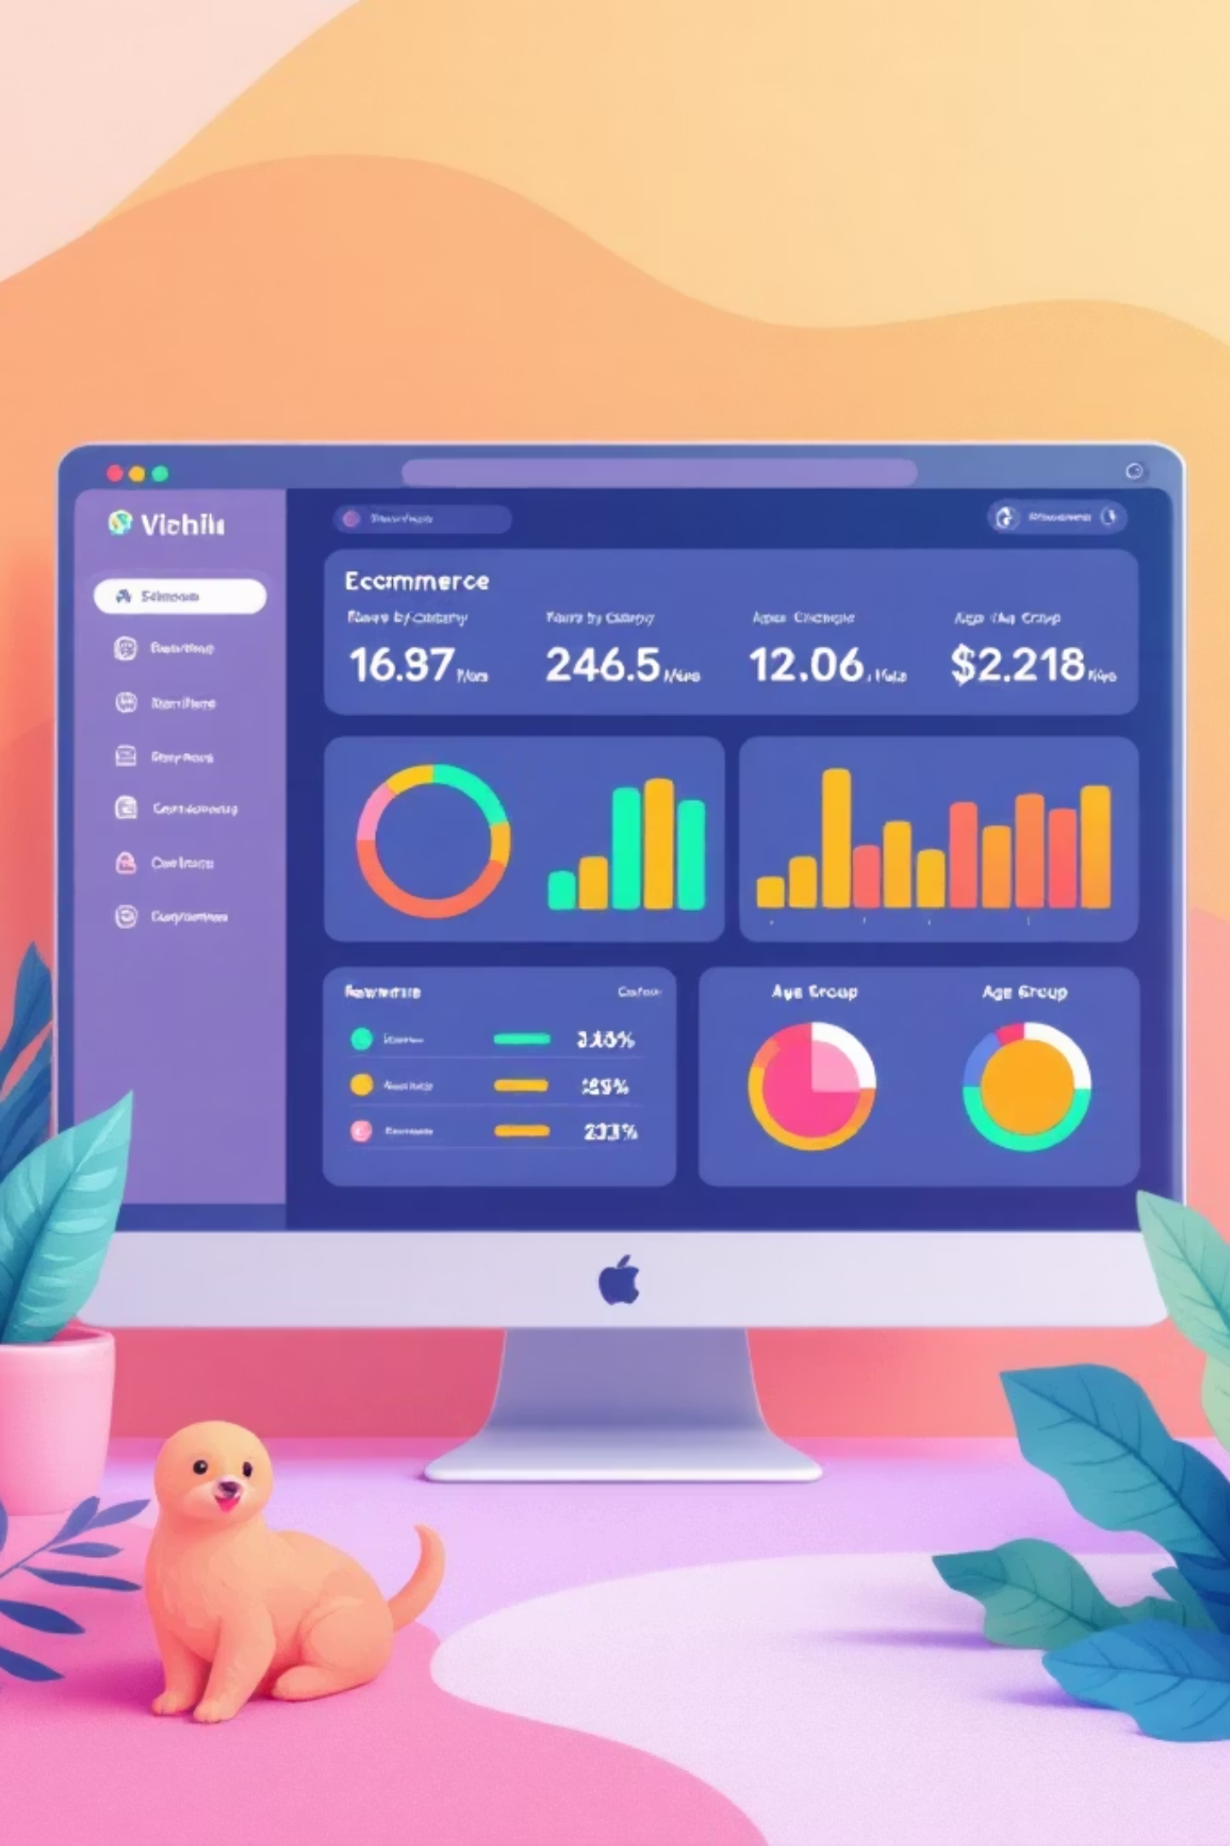
Sales & Revenue Highlights
Revenue by Category
Sales by Category
Clothing 100K • Accessories 70K • Footwear 30K • Outerwear 20K
Clothing 2,000 • Accessories 1,500 • Footwear 700 • Outerwear 400
Revenue by Age Group
Young Adult 60K • Middle-aged 55K • Adult 50K • Senior 45K

Slide 10
Recommendations
Boost Subscriptions
Promote exclusive subscriber benefits
Loyalty Programs
Reward repeat buyers to grow Loyal segment
Review Discount Policy
Balance sales lift with margins
Product Positioning
Highlight top-rated & best-sellers
Targeted Marketing
Focus on high-revenue age groups & express-shipping users

